Slide 1
Introduction to Reinforcement Learning
Subrahmanya Chandra Bhamidipati

Slide 2
Overview
What and why RL
Markov Decision Process
Core Concepts
Types of RL Algorithms
Practical Examples
Challenges

Slide 3
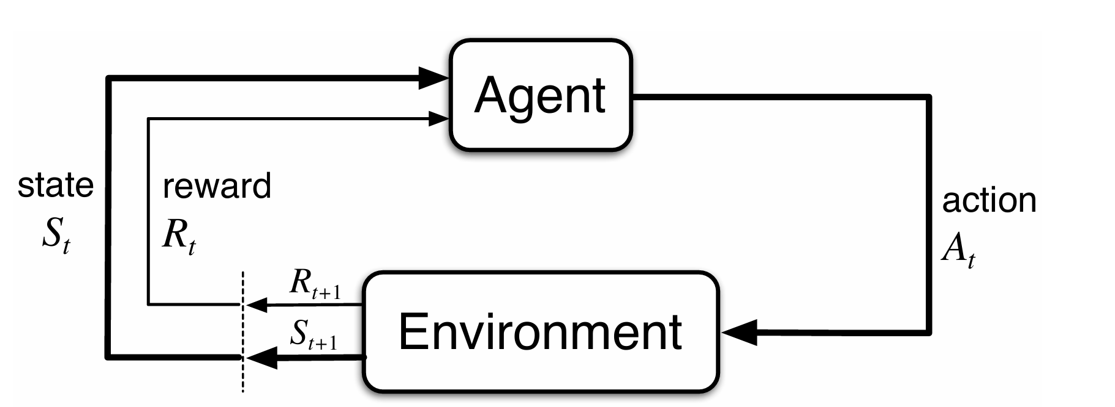
What is Reinforcement Learning
Type of ML algorithm
Agent performs Action, receives Feedback regarding Action
Feedback is Reward (or Penalty)

Slide 4
Why Reinforcement Learning
Learn from interaction
Doesn’t need labeled dataset
Learns from consequences
Decisions under uncertainty
Optimization
Can optimize both long term and short terms goals ™
Adaptability
Can adapt to almost any problem

Slide 5
Discussion
How are the Rewards and States generated?

Slide 6
Markov Decision Process (MDP)
Framework for modeling decision making
Results are partly random or partly under agent control
Key Components
States (S)
Actions (A)
Transition Function (P)
Rewards (R)
Bellman Equations
Outputs
Policy (π): Agent strategy
a = π(s)
Objective
Maximize rewards

Slide 7
Bellman Equation Prelude 1
Value of Current State
s : Current state
s’ : Next state
a : Action
V(s) : Value of Current state
V(s’) : Value of Next state

Slide 8

Bellman Equation Prelude 1
Finding value of Current State
s : Current state
s’ : Next state
a : Action
V(s) : Value of Current state
V(s’) : Value of Next state
$$V\left(s\right)=\max_{a}\left(V\left(s′\right)\right)$$

Slide 9
Bellman Equation Prelude 2
Reward (R)
Cost associated with ‘movement’
s : Current state
s’ : Next state
a : Action
V(s) : Value of Current state
V(s’) : Value of Next state

Slide 10

Bellman Equation Prelude 2
Reward (R)
Cost associated with ‘movement’
s : Current state
s’ : Next state
a : Action
V(s) : Value of Current state
V(s’) : Value of Next state
R(s,a) : Reward of State ‘s’ & Action ‘a’
$$V\left(s\right)=\max_{a}\left(R\left(s,a\right)+V\left(s′\right)\right)$$

Slide 11
Bellman Equation Prelude 3
Discount Factor (γ)
100$ now is worth more than 100$ ten years later
Similarly, Reward now is better than Reward later
s : Current state
s’ : Next state
a : Action
V(s) : Value of Current state
V(s’) : Value of Next state
R(s,a) : Reward of State ‘s’ & Action ‘a’

Slide 12
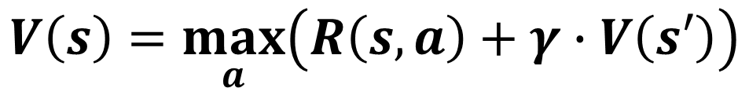
Bellman Equation
Discount Factor (γ)
100$ now is worth more than 100$ one year later
Similarly, Reward now is better than Reward later
Multiply by γ
s : Current state
s’ : Next state
a : Action
V(s) : Value of Current state
V(s’) : Value of Next state
R(s,a) : Reward of State ‘s’ & Action ‘a’
$$V\left(s\right)=\max_{a}\left(R\left(s,a\right)+γ∙V\left(s′\right)\right)$$

Slide 13
Core concepts in RL
Policy
Rewards
Value Function
Exploration vs Exploitation
← Did not achieve yet

Slide 14
Types of RL algorithms
Model Based vs Model Free
Model Based: Agent builds the model & learns through interactions
Eg: Chess, Go
Model Free: Agent learns by policy or value functions
Eg: Video games
On-Policy vs Off-Policy
On-Policy: Improve the Policy used to make decisions
Eg: SARSA
Off-Policy: Improve different Policy from the one used to make decisions
Eg: Q-Learning

Slide 15
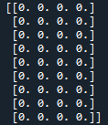
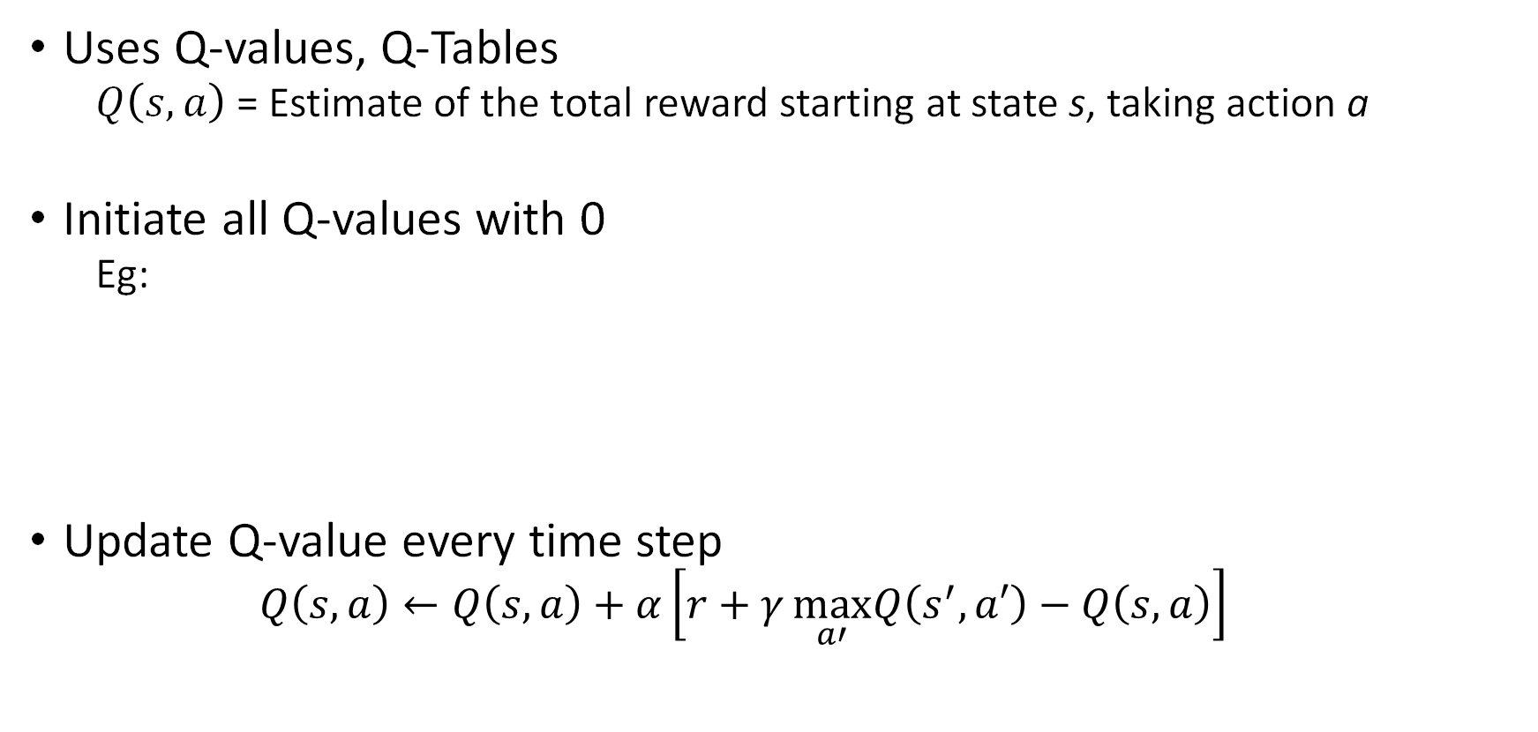

Q-Learning: “Quality” Learning
$$a_{1}a_{2}a_{3}a_{4}$$
$$s_{1}$$
$$s_{2}$$
$$s_{3}$$
$$s_{4}$$
$$s_{5}$$
$$s_{6}$$
$$s_{7}$$
$$s_{8}$$
$$s_{9}$$
Uses Q-values, Q-Tables
$Q\left(s,a\right)$= Estimate of the total reward starting at state s, taking action a
Initiate all Q-values with 0
Eg:
Update Q-value every time step
$$Q\left(s,a\right)←Q\left(s,a\right)+α\left[r+γ\max_{a′}Q\left(s^{′},a′\right)−Q\left(s,a\right)\right]$$
?

Slide 16
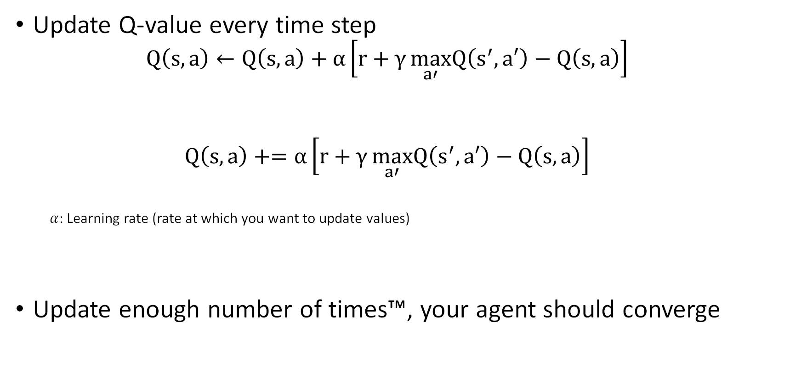
Q-Learning: “Quality” Learning
Update Q-value every time step
$$Q\left(s,a\right)←Q\left(s,a\right)+α\left[r+γ\max_{a′}Q\left(s^{′},a′\right)−Q\left(s,a\right)\right]$$
$$Q\left(s,a\right)+=α\left[r+γ\max_{a′}Q\left(s^{′},a′\right)−Q\left(s,a\right)\right]$$
$α$: Learning rate (rate at which you want to update values)
Update enough number of times™, your agent should converge
Bellman Equation!

Slide 17
Exploration? Exploitation?
Always utilizes same Q values once it finds something
So, introduce forced randomness
Sometimes random action (explore), other times use above equation (exploit)
$$Q\left(s,a\right)←Q\left(s,a\right)+α\left[r+γ\max_{a′}Q\left(s^{′},a′\right)−Q\left(s,a\right)\right]$$
← Exploitation
← Exploration

Slide 18
ε-greedy Strategy
With probability ε, take a random action
With probability (1- ε), take the calculated best action
Why?
Try different actions for the chance there might be a better action

Slide 19
Q-learning off-policy
Policy 1: Behavior Policy i.e ε-greedy Strategy
Policy 2: Target Policy i.e Q-tables
← Use this policy
← To improve this policy

Slide 20
Practical Example 1
Setup: You start at 0.
You have two options:
× 2
+ 1
Goal: Reach a target, say 15
Find: Shortest way to reach target

Slide 21
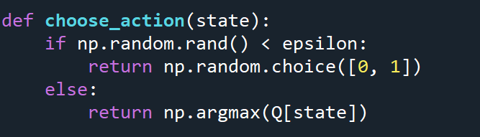
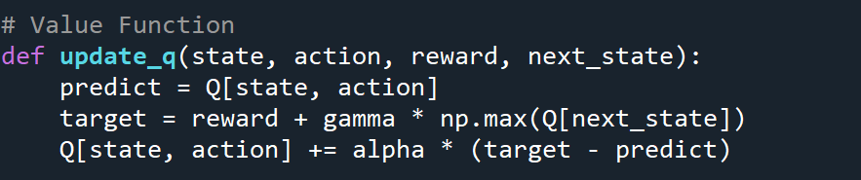
Apply core concepts
Exploration vs Exploitation
Policy
Rewards
Value Function
← Exploration
← Exploitation
← Value Function
← Policy
$$Q\left(s,a\right)+=α\left[r+γ\max_{a′}Q\left(s^{′},a′\right)−Q\left(s,a\right)\right]$$

Slide 22
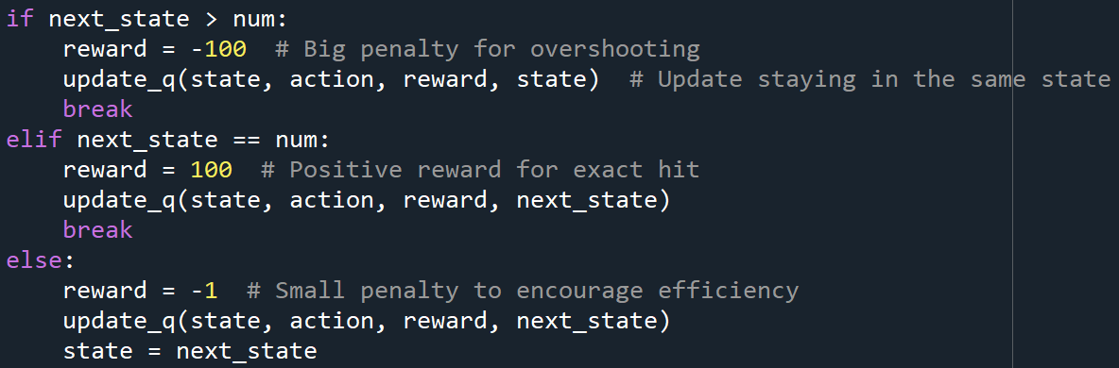
Apply core concepts
Exploration vs Exploitation
Policy
Rewards
Value Function

Slide 23
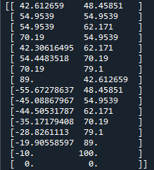







Final Q-table
× 2 +1
Actions
0
1
2
3
4
5
6
7
8
9
10
11
12
13
14
15
$$0\underset{→}{+1}1$$
$$1\underset{→}{×2}2$$
Final Path
$$2\underset{→}{+1}3$$
15:
+1
×2
+1
×2
+1
×2
+1
$$3\underset{→}{×2}6$$
$$6\underset{→}{+1}7$$
States
$$7\underset{→}{×2}14$$
$$14\underset{→}{+1}15$$

Slide 24
Extended Example 1
Try to reach different numbers, not just 15, notice the Q-tables
Try with 10000 episodes and then try increasing them

Slide 25
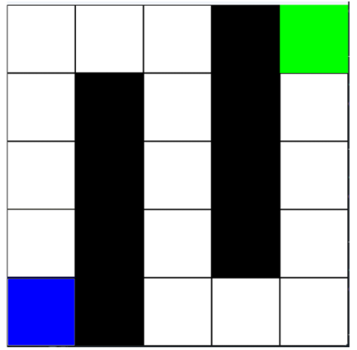
Practical Example 2
Navigate through a Gridworld from Start to Finish
Move Up, Down, Left or Right
Find the fastest way (only way in this case)
Goal
Start

Slide 26
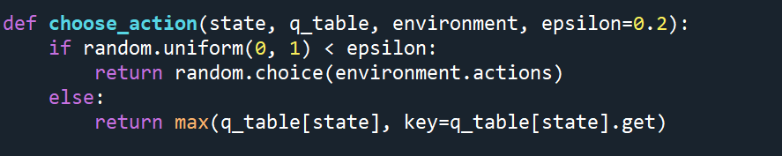
Apply core concepts
Exploration vs Exploitation
Policy
Rewards
Value Function
$$Q\left(s,a\right)+=α\left[r+γ\max_{a′}Q\left(s^{′},a′\right)−Q\left(s,a\right)\right]$$

Slide 27
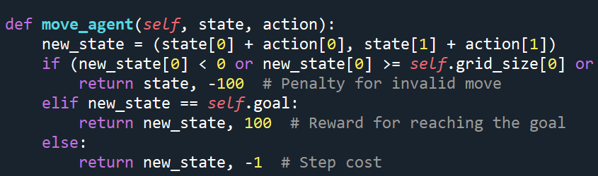
Apply core concepts
Exploration vs Exploitation
Policy
Rewards
Value Function
There’s more here but, I wanted to save space

Slide 28
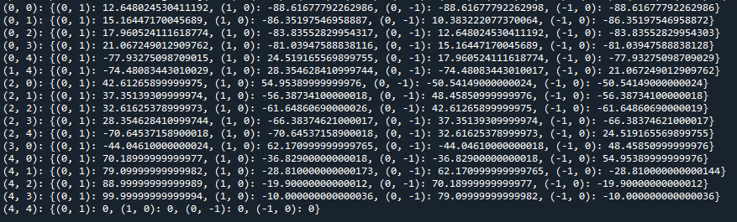
Setup & Q-Table
Actions: { ←, ↑, →, ↓}
Path: Obvious
Goal
Start

Slide 29
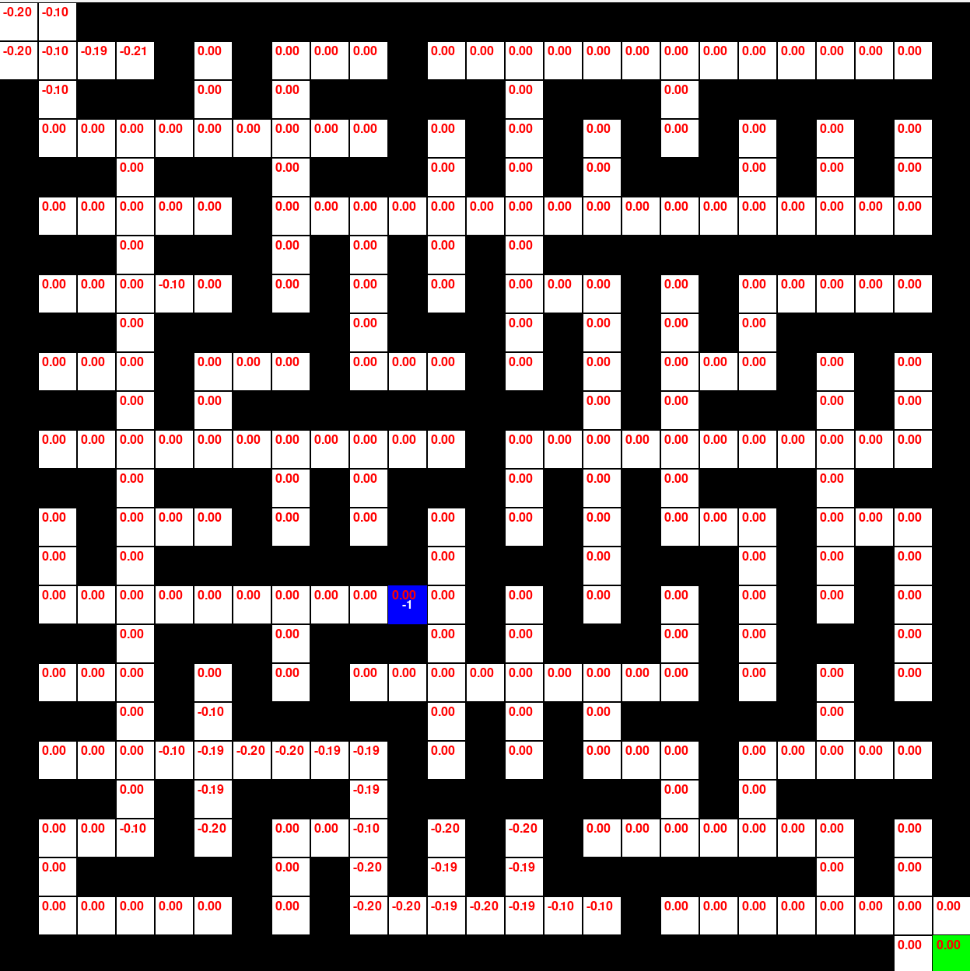
Extended Example
Start
Goal

Slide 30
Challenges in RL
Large number of interactions to learn good policies
Balance exploration vs exploitation
Future Rewards (How long should it wait?)
Convergence
More Dimensions = Recipe for disaster

Slide 31
Questions?

